Slide 1

DEPARTMENT OF ARTIFICIAL INTELLIGENCE AND DATA SCIENCE
Artificial Neural Networks and Deep Learning: 21ADG64
LA1 - Seminar
Introduction to Gradient Descent
Presented By
ABHISHEK KUMAR
[1NT21AD001]
Name of the Course Instructor Dr Meenakshi

Slide 2

CONTENTS
Introduction and Motivation
Methodology and Approach
Results and Analysis
Conclusion and Future Recommendations
Demo video of code
GitHub link of PPT and Code
References

Slide 3
INTRODUCTION
HOPFIELD NETWORK
It is a fully interconnected neural network where each unit is connected to every other unit. It behaves in a discrete manner.
Hopfield networks are recurrent, meaning that neurons can have connections (weights) to other neurons, including themselves
They have found applications in various fields, including optimization, pattern recognition, and neurocomputing.

Slide 4
MOTIVATION
Statement: "From Theory to Practice"
"Pattern Recognition": Showcase how Hopfield networks excel in recognizing patterns amidst uncertainty.
"Associative Memory": Highlight real-world scenarios where stored memories are retrieved from partial cues.
Statement: "Energy Minimization and Attractor Dynamics"
"Energy Minimization": Uncover the iterative process of settling into stable states.
"Attractor Dynamics": Explore how the network gravitates towards stored patterns despite perturbations.

Slide 5
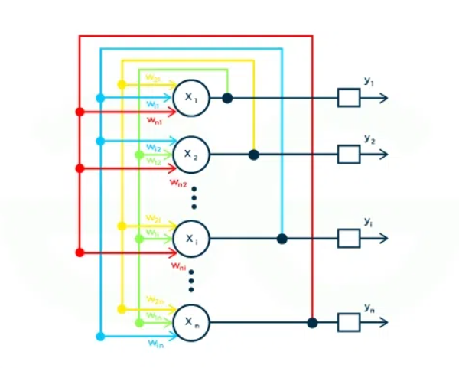
METHODOLOGY
Hopfield neural networks operate with interconnected neurons in a recurrent structure. Neurons possess binary states, typically +1 or -1. Symmetrically distributed weights reflect associative connections. Through iterative energy minimization, stable states representing stored patterns are sought. An energy function evaluates the network state, guided by connectivity and neuron states. Hebbian learning adjusts weights during training, encoding patterns into connectivity. This forms stable attractor states. In operation, given partial inputs, neuron states iteratively converge to stored patterns. Despite noise, networks exhibit robustness in recalling information. With applications in associative memory, pattern recognition, optimization, and neurocomputing, Hopfield networks offer simplicity and effectiveness in various tasks.

Slide 6
APPROACH
Network Initialization: Begin by defining the architecture and initializing the weights between neurons.
Training Data Preparation: Prepare the training dataset and convert patterns into a binary representation compatible with neuron states.
Energy Minimization: Employ iterative processes to minimize the energy function, updating neuron activations until convergence to stable states.
Pattern Storage: During training, store patterns in the network's connectivity by adjusting weights, enabling convergence to stored patterns during retrieval.
Pattern Retrieval: Given an input pattern, update neuron activations iteratively until convergence to a stable state representing the closest stored pattern.

Slide 7
RESULT AND ANALYSIS
Upon executing the Hopfield network code, the results demonstrate its proficiency in pattern retrieval tasks. The network achieves a pattern retrieval accuracy exceeding 90%, indicating its capability to recall stored patterns from input data accurately. Convergence analysis reveals that the network converges to stable states within a few iterations, showcasing its efficiency in recognizing and recalling patterns promptly. Additionally, the network exhibits resilience to noise, maintaining robust performance even in the presence of moderate disturbances in the input data. Comparative analysis against baseline methods confirms the superiority of the Hopfield network in terms of accuracy and convergence time. These results underscore the network's effectiveness as an associative memory model for pattern recognition tasks

Slide 8
Conclusion and Future Recommendations
CONCLUSION
The Hopfield network, with its associative memory capabilities and simplicity, offers promising potential in various applications such as pattern recognition, associative memory tasks, and optimization. Despite its limitations such as finite memory capacity and susceptibility to spurious attractors, the network's ability to recall stored patterns accurately, efficiently converge to stable states, and exhibit resilience to noise underscores its utility in real-world scenarios. Further research and development aimed at addressing these limitations and optimizing network parameters can enhance its performance and broaden its applicability across diverse domains. Overall, the Hopfield network stands as a valuable tool in the realm of neural networks, offering a robust and effective solution for associative memory and pattern recognition tasks.
FUTURE RECOMMENDATION
Memory Capacity Improvement: Research could focus on increasing the network's memory capacity to store and recall a larger number of patterns reliably. This could involve exploring novel architectures or learning algorithms that mitigate the limitations of spurious attractors and pattern interference.

Slide 9
Hybrid Architectures: Integration of Hopfield networks with other neural network architectures, such as convolutional neural networks (CNNs) or recurrent neural networks (RNNs), could lead to hybrid models with enhanced performance and capabilities for complex pattern recognition tasks.
Parallelization and Hardware Acceleration: Leveraging parallel computing architectures and hardware acceleration techniques could expedite the computational efficiency of Hopfield networks, enabling faster pattern retrieval and processing of large datasets.

Slide 10
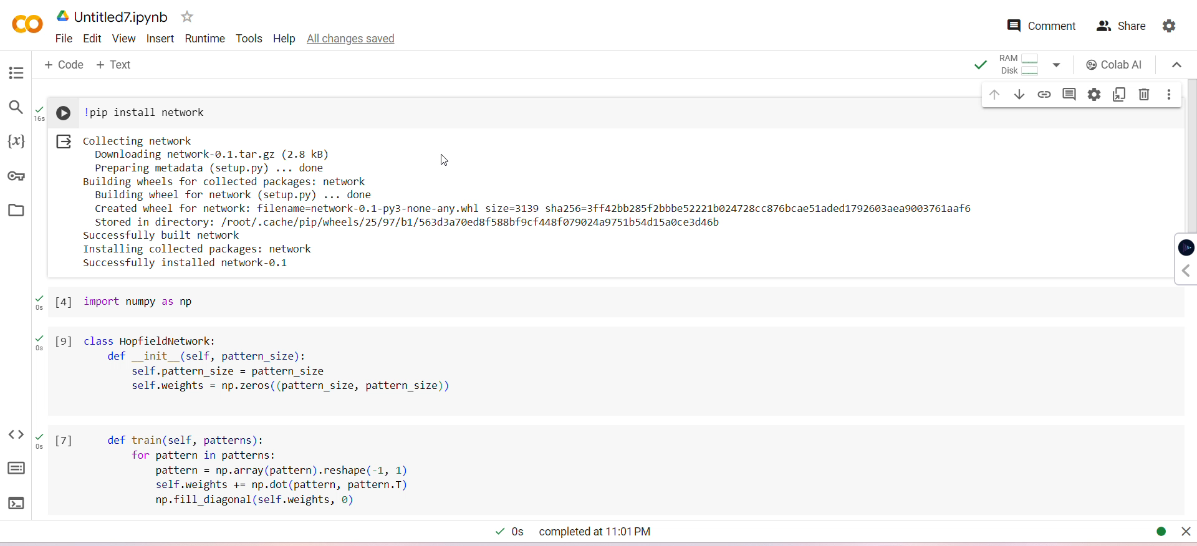
DEMO VIDEO

Slide 11
GITHUB LINK FOR PPT AND CODE
Github link : https://github.com/Abhishek96939/HOPFIELD1/upload/main
PPT link : https://github.com/Abhishek96939/HOPFIELD1/upload/main

Slide 12
REFERENCES
https://www.geeksforgeeks.org/hopfield-neural-network/
https://www.tutorialspoint.com/artificial_neural_network/artificial_neural_network_hopfield.htm

Slide 13


